Slide 1

BOTANICA
Sproutbot

Slide 2


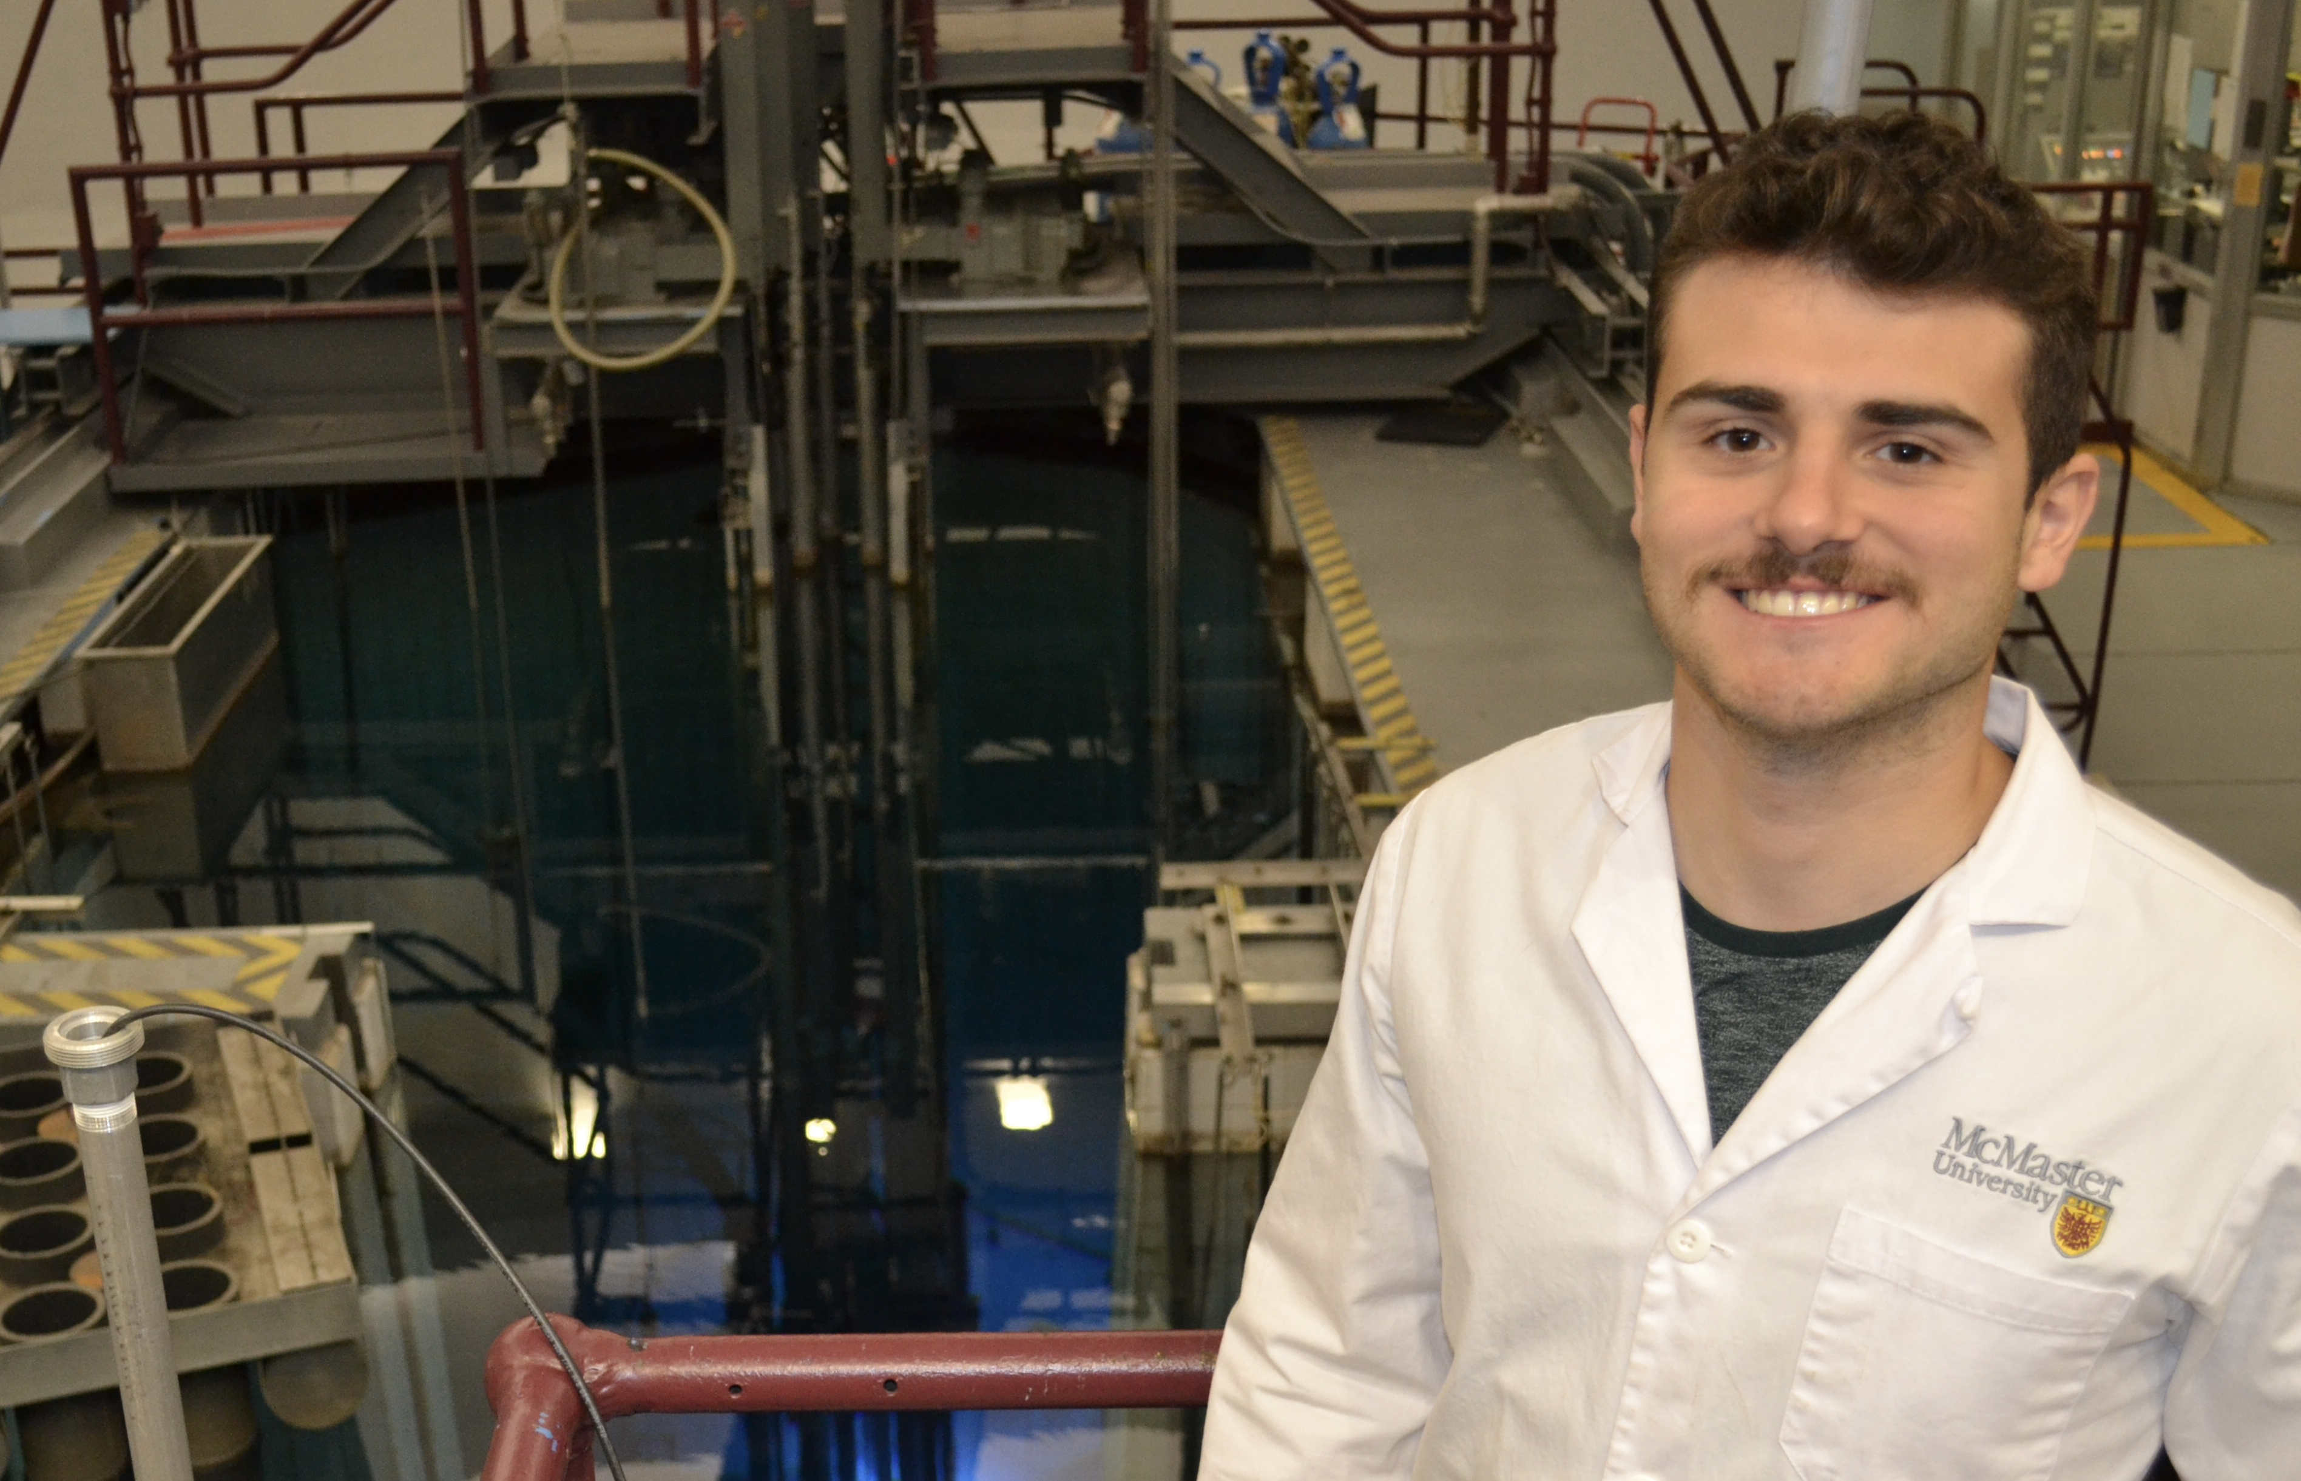

MEET THE TEAM
Arun Mistry
Mina Demian
Nicholas Levantis
Usman Minhas

Slide 3



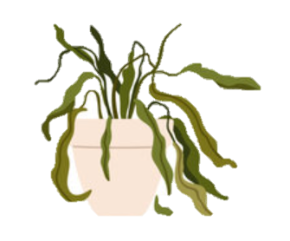
MOTIVATION
Busy Schedules
Out of Town
Laziness

Slide 4
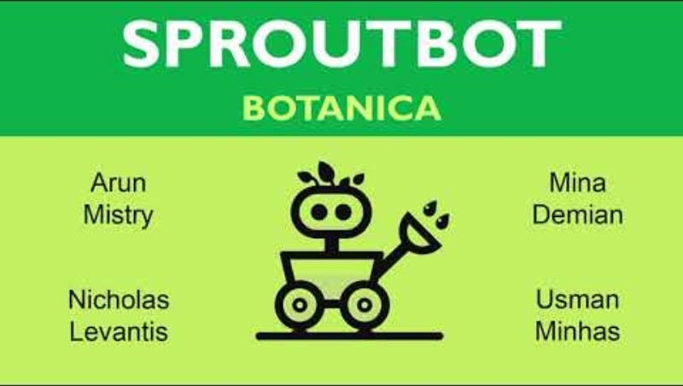
VIDEO OVERVIEW

Slide 5
DEMONSTRATION
Watering Arm

Slide 6
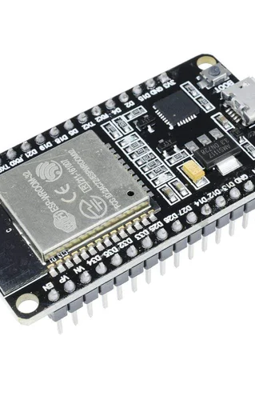
Control
Microcontrollers on robot, base and each plant
Communicate wirelessly

Slide 7
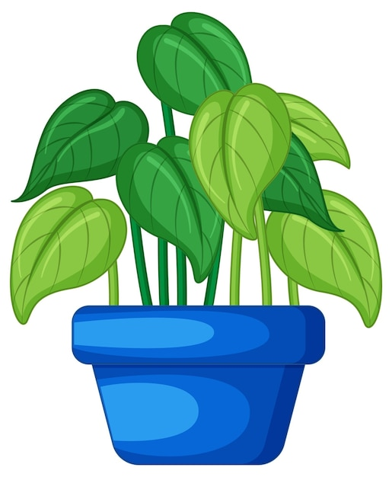
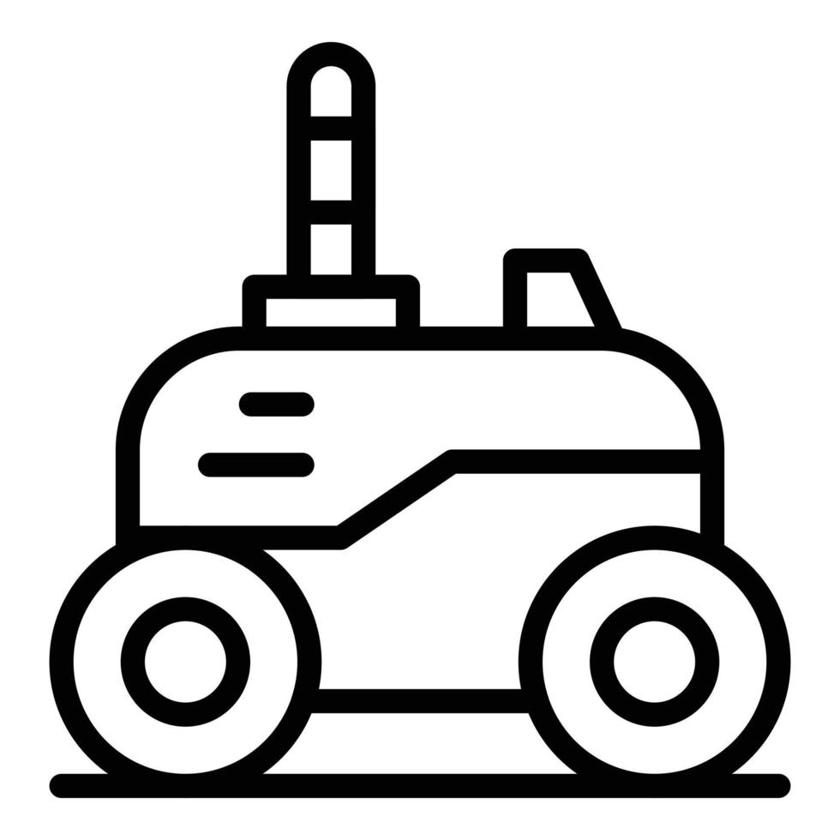

NAVIGATION – COMPONENTS
Plant
Robot
Base
ESP 32 (WiFi)
IR Emitter
ESP 32 (WiFi)
IR Receiver
Ultrasonic Sensor
ESP 32 (WiFi)
IR Emitter

Slide 8
NAVIGATION – SOFTWARE
Find Plant
Move to Plant
Stop at Plant
Find Base
Move to Base
Stop at Base

Slide 9
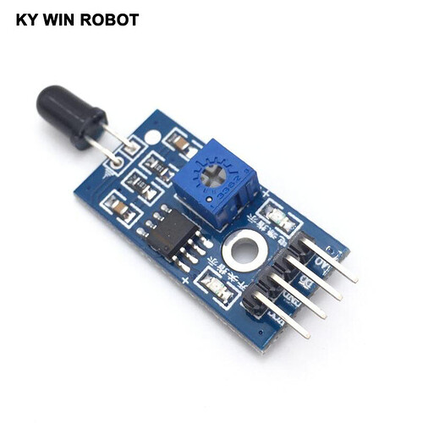
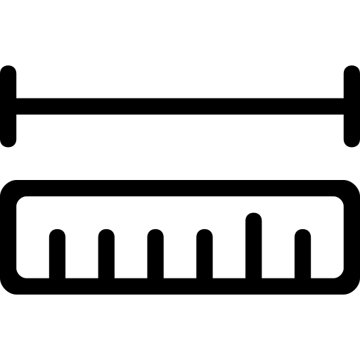
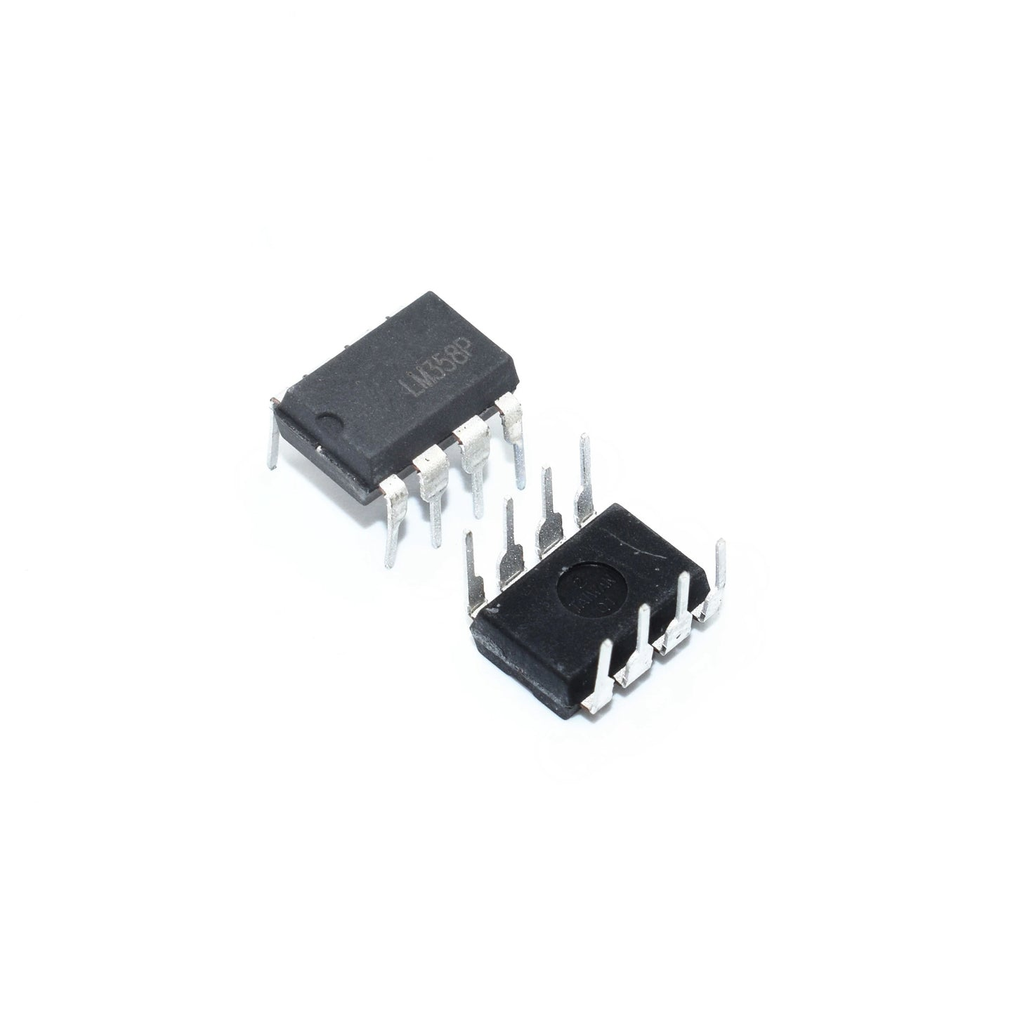
NAVIGATION – DETECTION
Initial Plan
Problem
Solution

Slide 10
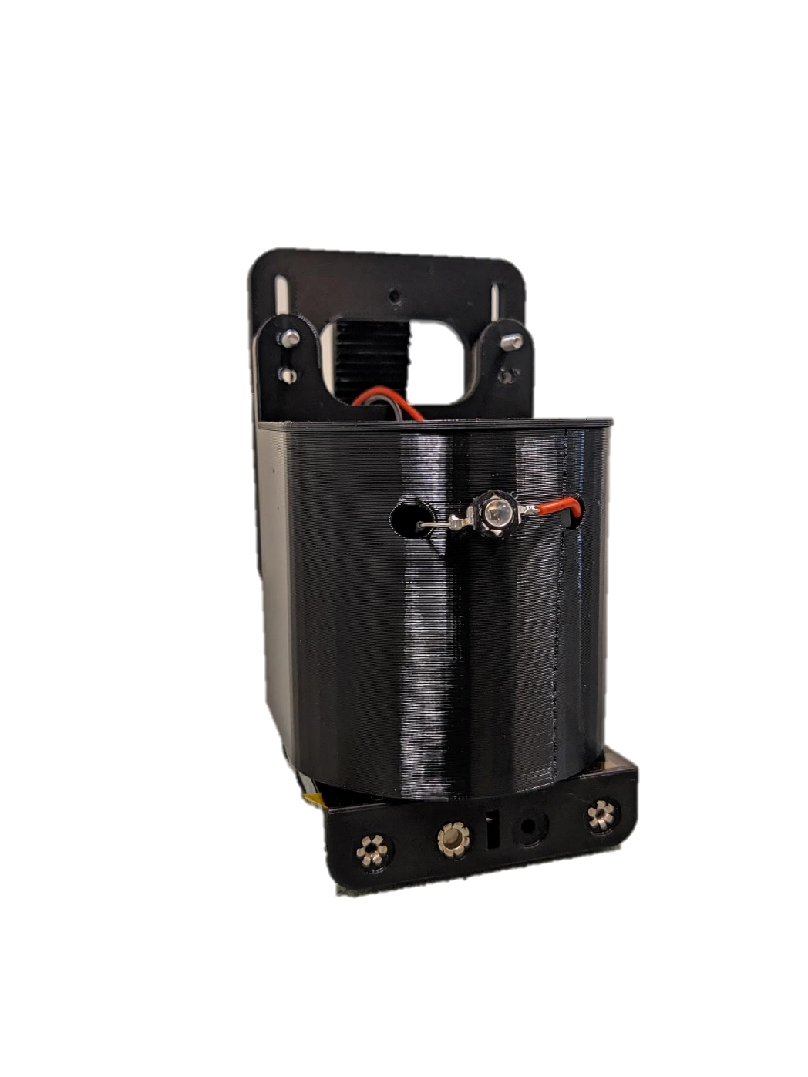
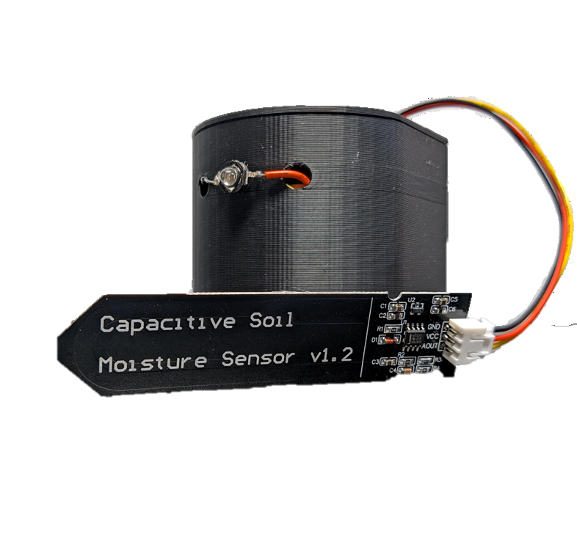
PLANT MODULE
Hook
IR Emitter
Battery
Soil Moisture Sensor

Slide 11
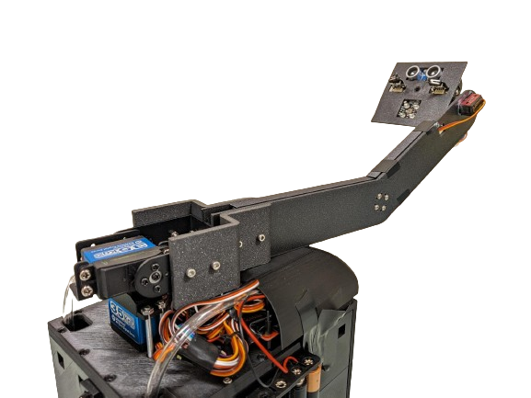
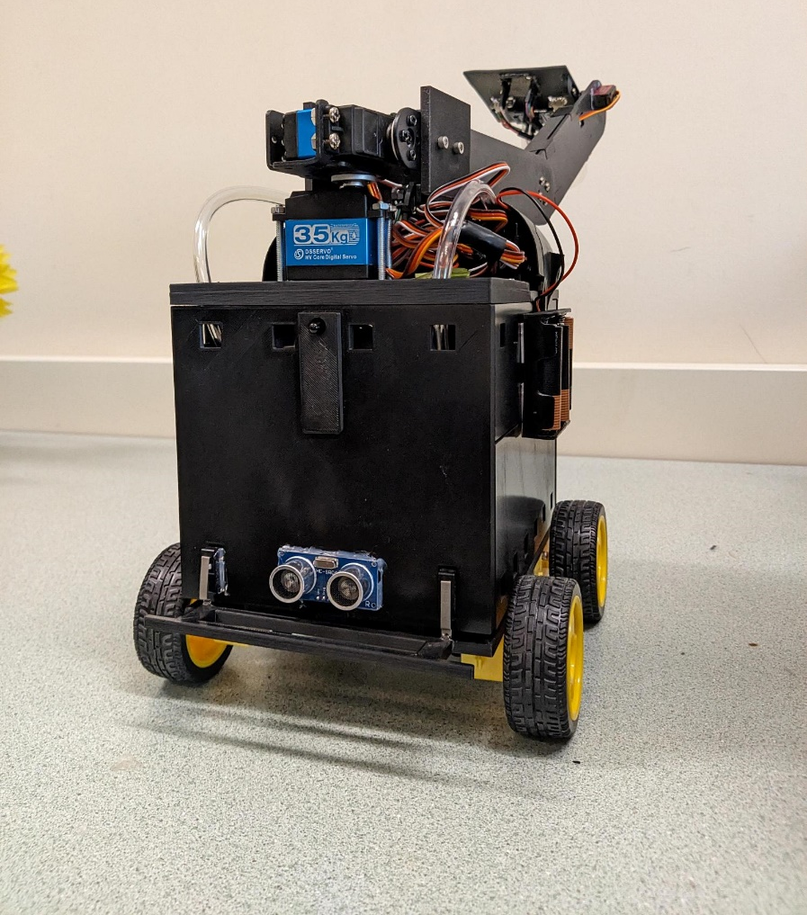
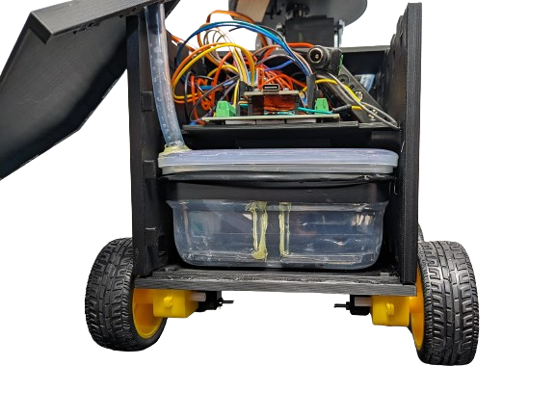
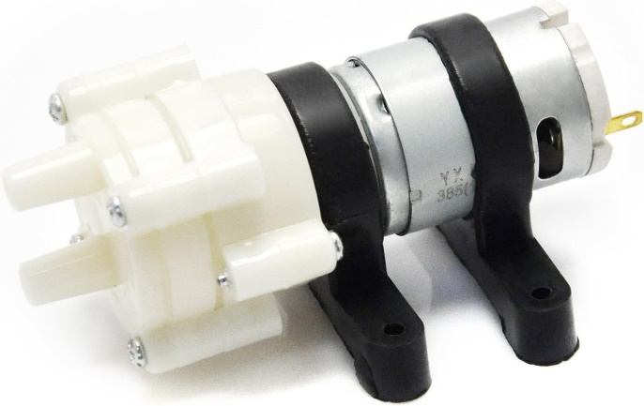
Watering mechanism
Watering Arm
850 mL Water Tank
DC Water Pump

Slide 12
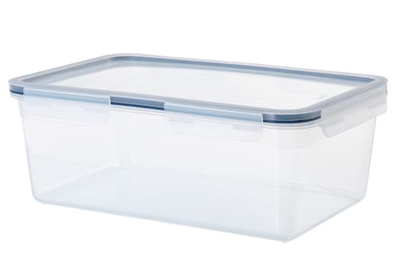
TANK SIZE (850 mL)
Lightweight
Save on motors and power
Enough water for average plants for up to 12 days [1]

Slide 13
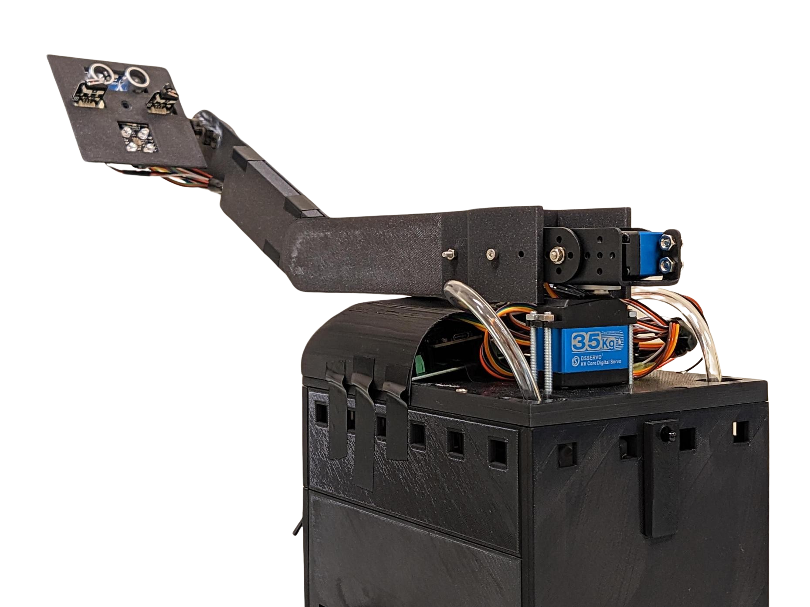
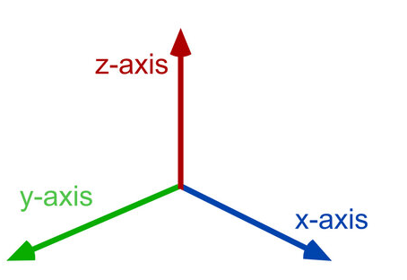
HARDWARE – WATERING ARM
Sensor/Wrist Servo
Shoulder Servo
Sensor Mount
Base Servo

Slide 14
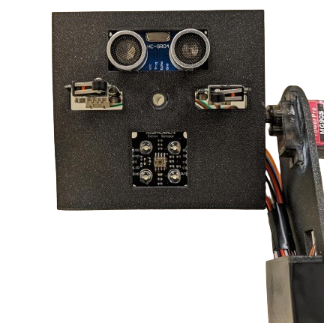
HARDWARE – SENSOR MOUNT
Ultrasonic Distance Sensor
Micro-Switch
Wrist Servo
Watering Outlet
Color Sensor

Slide 15


WATERING TARGET
Initial Plan
Problem
Solution

Slide 16
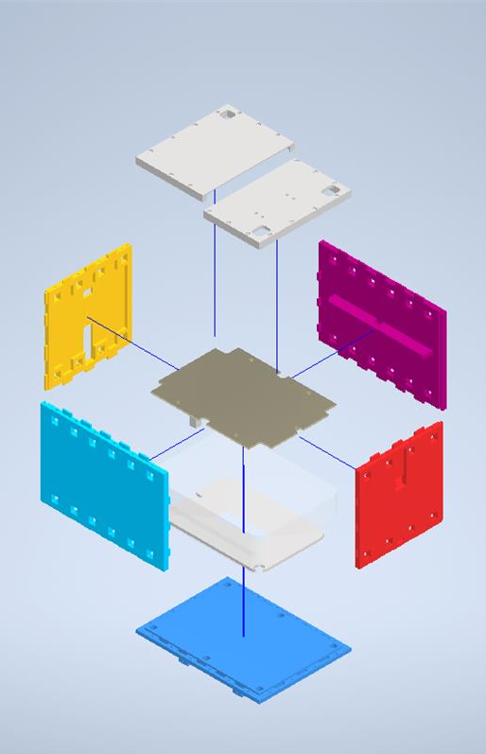
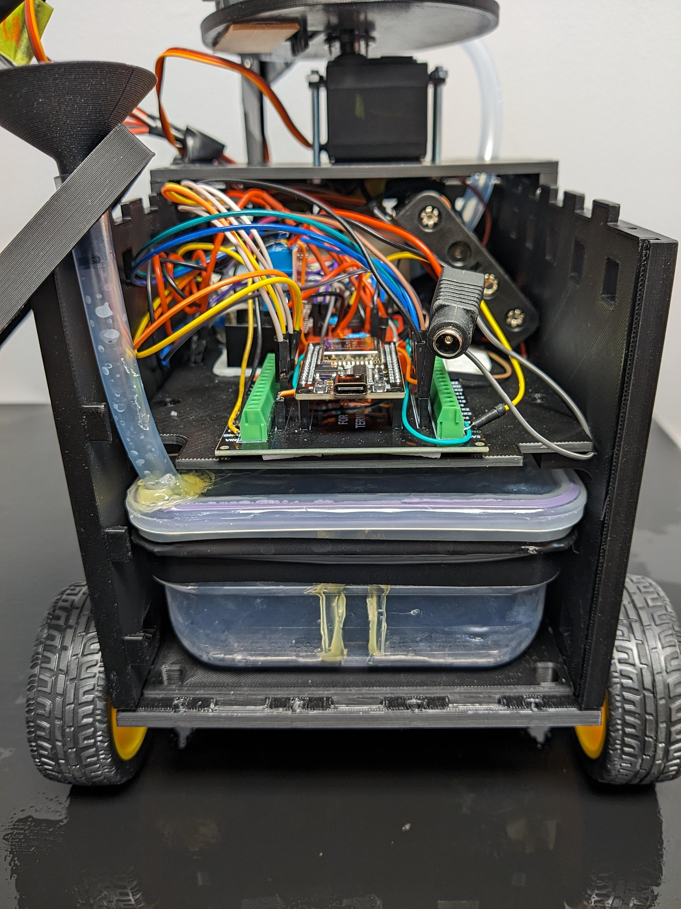
HARDWARE - CASING

Slide 17
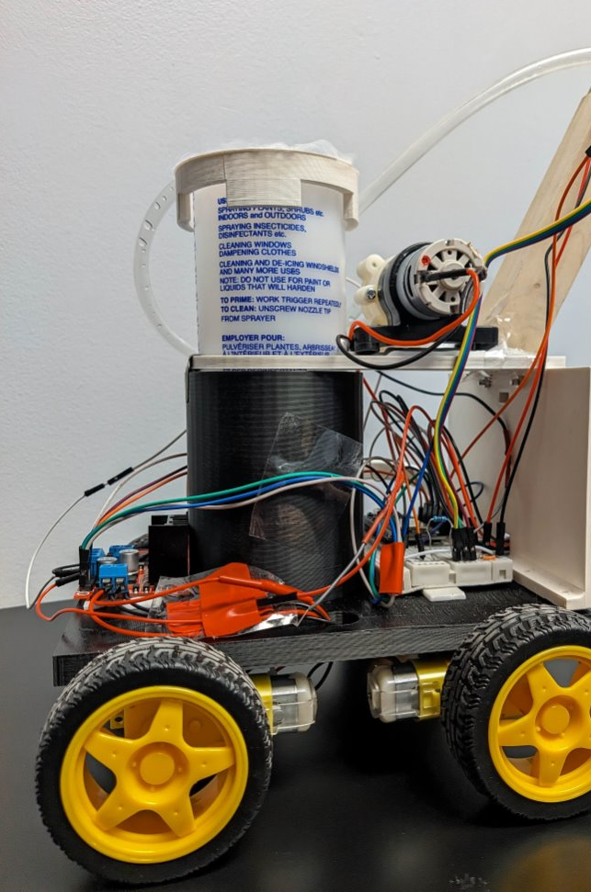
SAFETY - SPILLS
Revision 0 had exposed circuitry
Moved tank under electronics
Lower center of gravity
Waterproof servo motors
Revision 0 vs Final

Slide 18
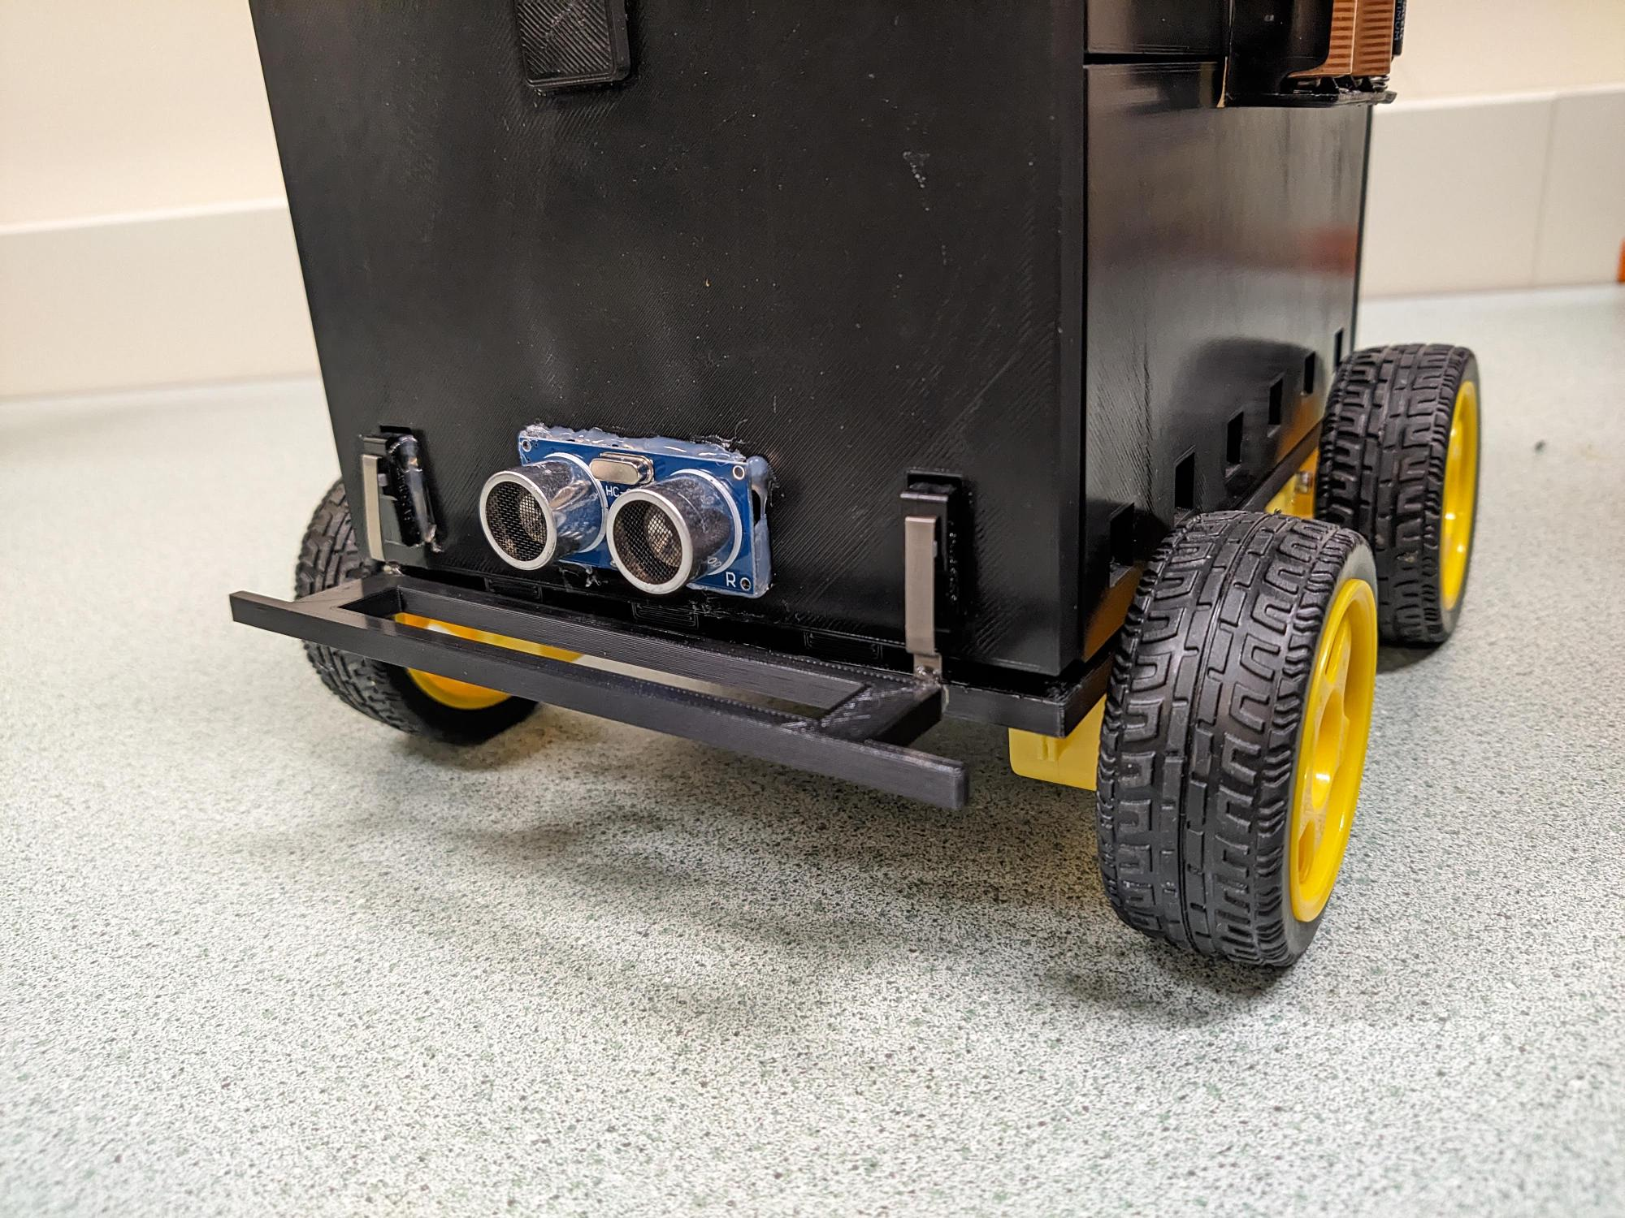
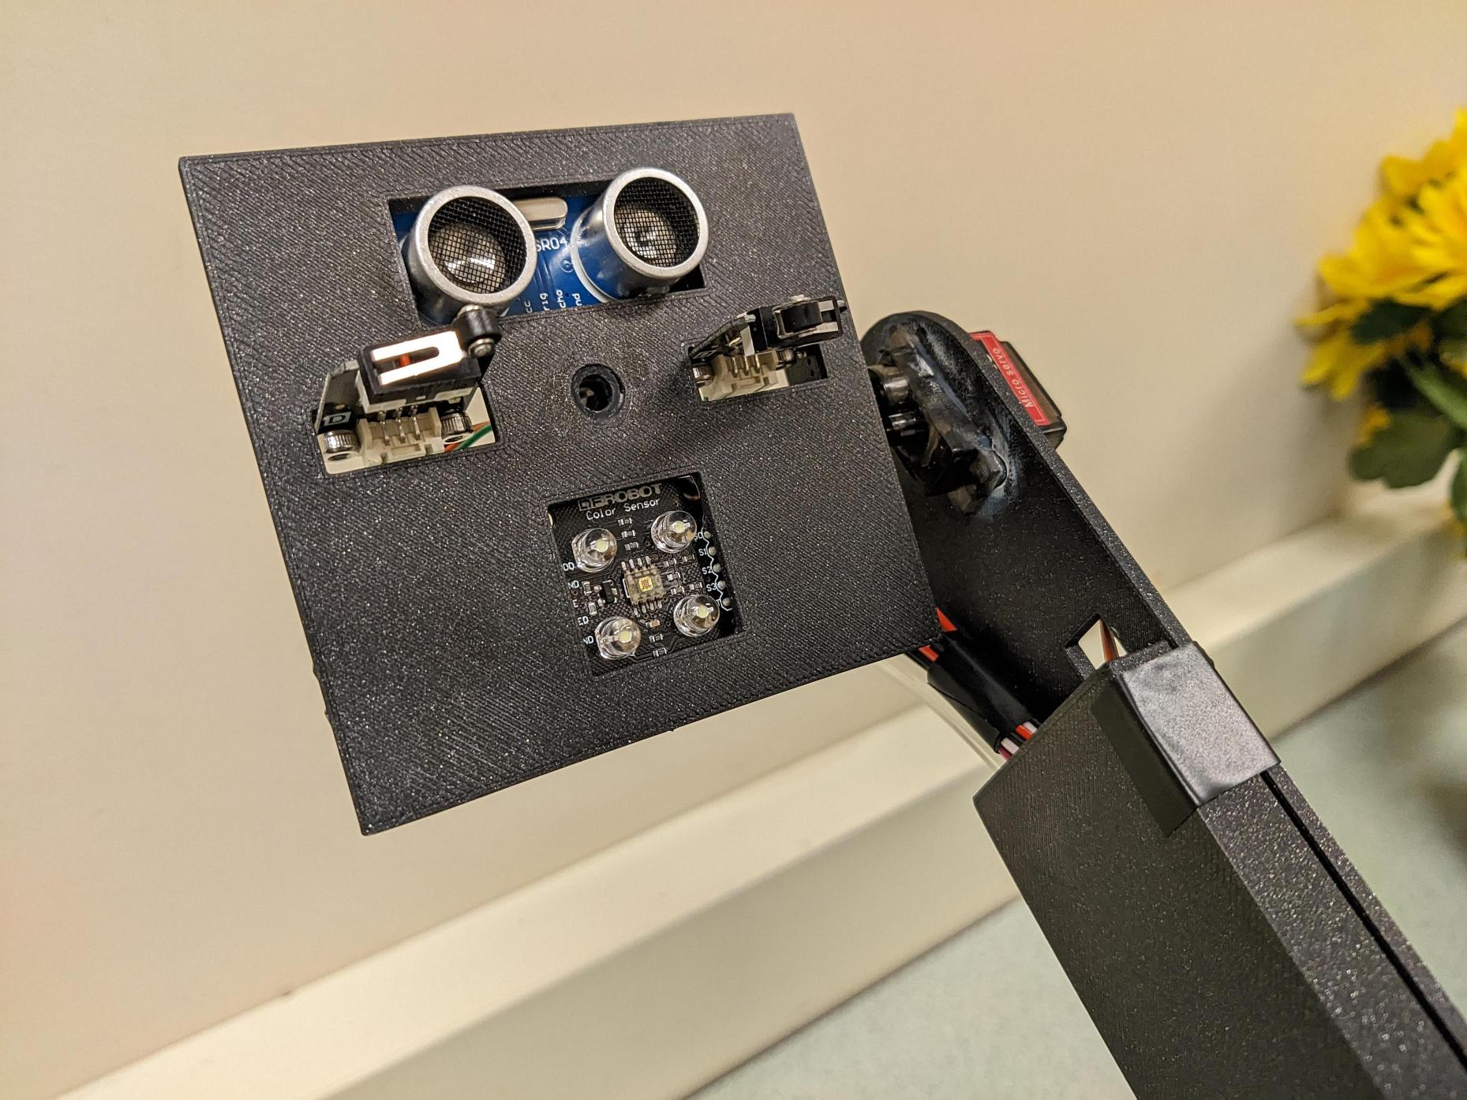
SAFETY - CRASH DETECTION
Limit Switches
Bumper

Slide 19
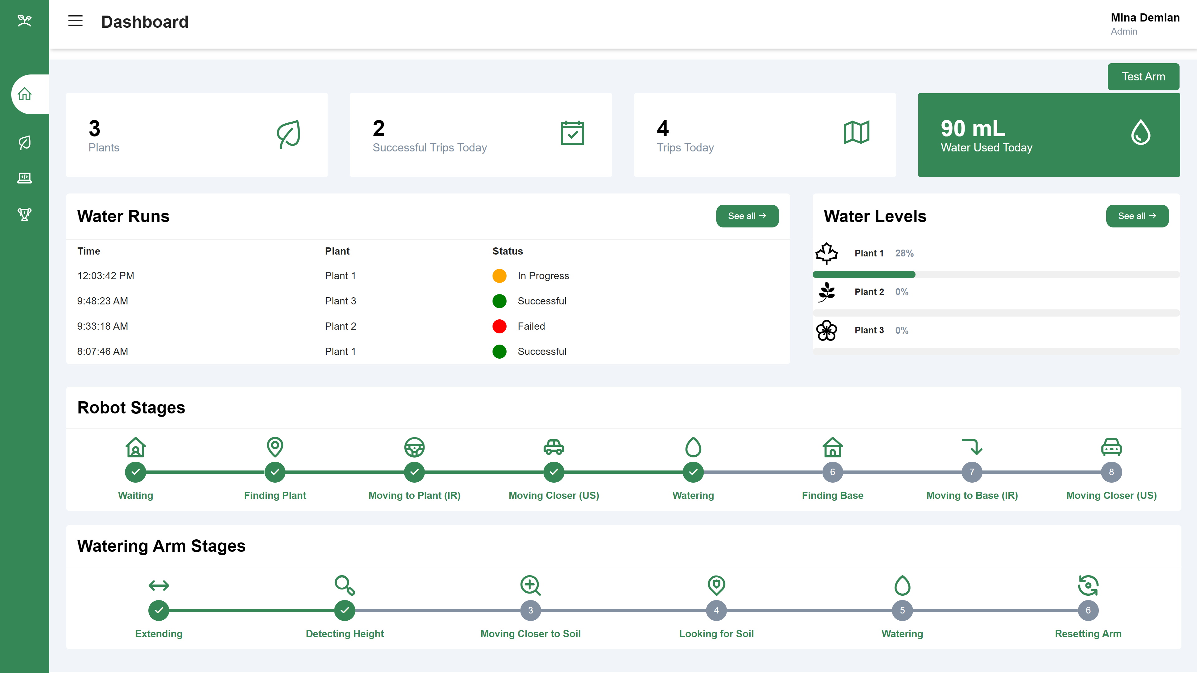
WEBSITE

Slide 20
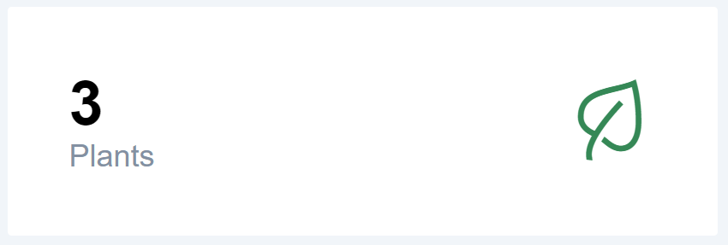


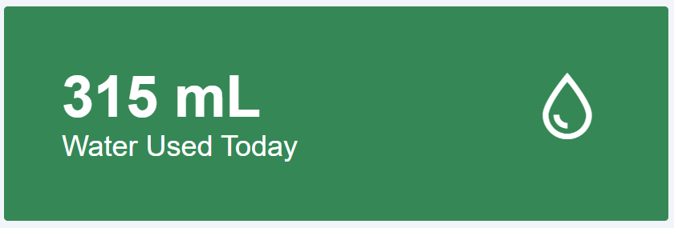
GENERAL SPROUTBOT INFO
# of Plants Setup
# of Water Runs Attempted
# of Successful Water Runs
Amount of Water Used

Slide 21
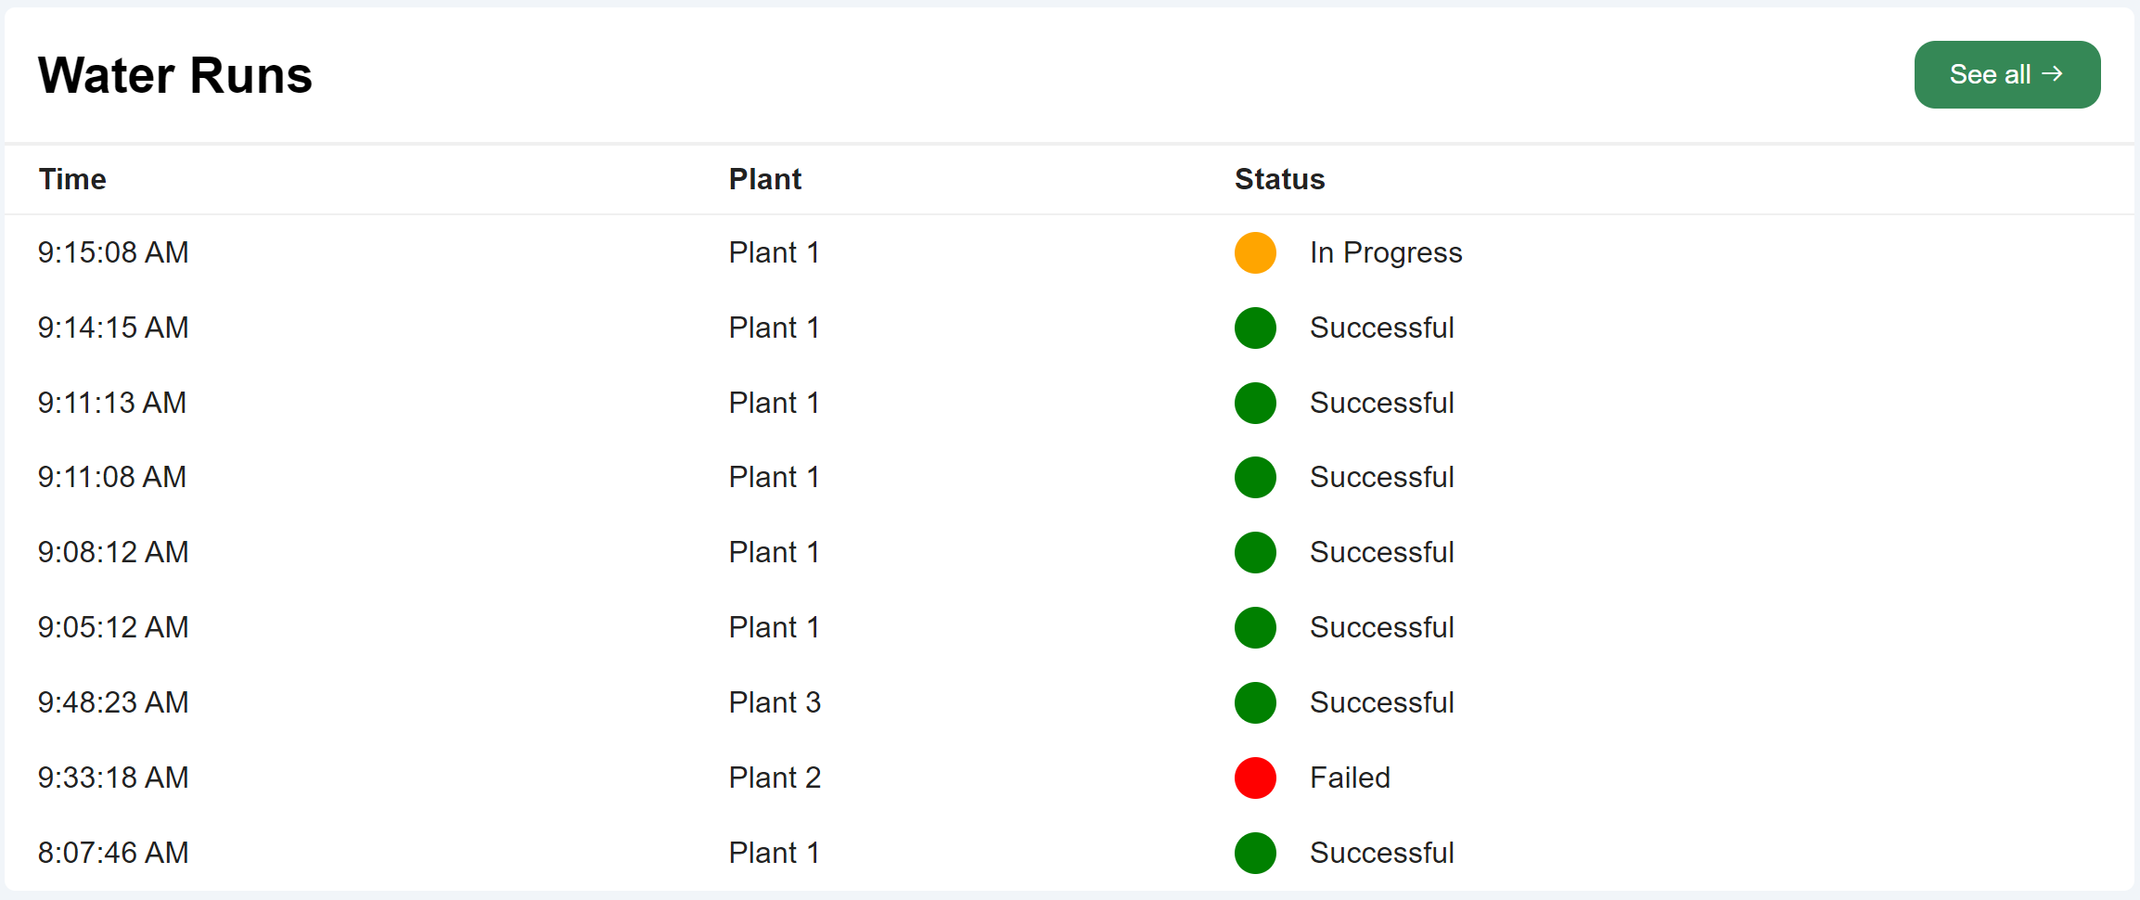
RECENT WATER RUNS
Time of Run
Plant ID
Status of Run

Slide 22
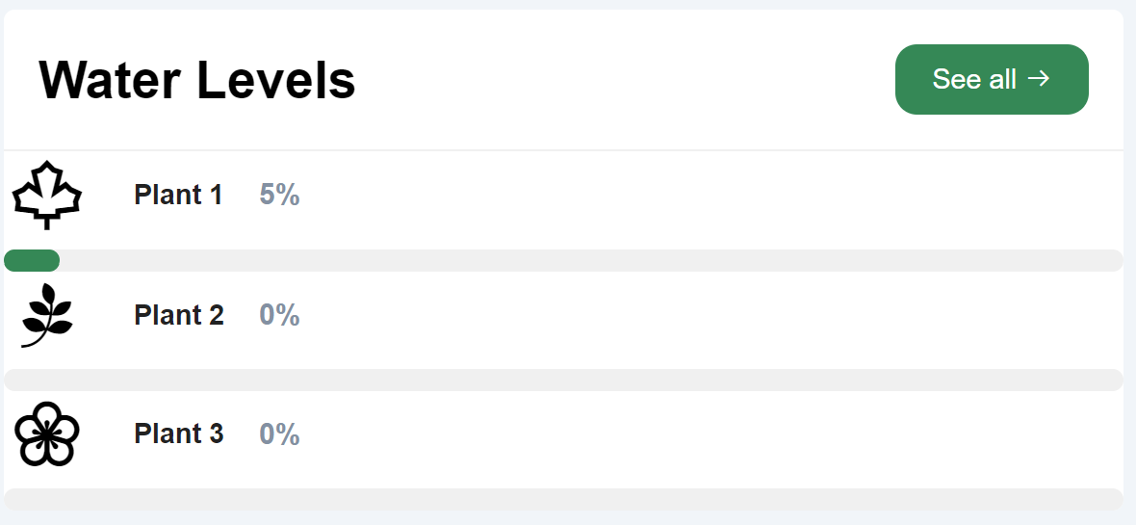
PLANT WATER LEVELS
Plant Moisture Level

Slide 23
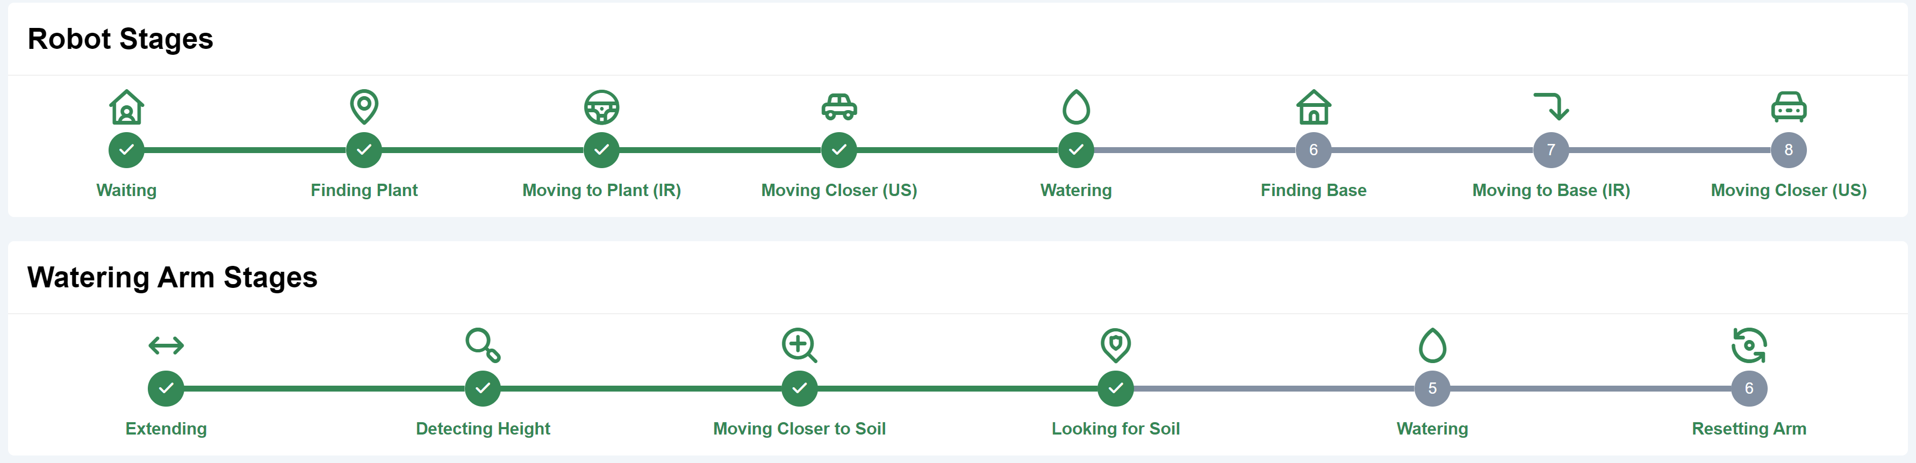
PROGRESS INDICATORS
Progress of Robot State
Progress of Watering Arm State

Slide 24




MARKET ANALYSIS
COVID-19 & Gardening Boom
Global Garden Robot Market
Untapped Market

Slide 25
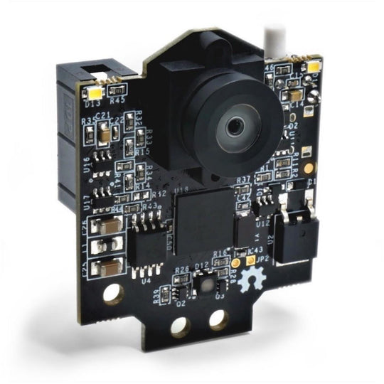
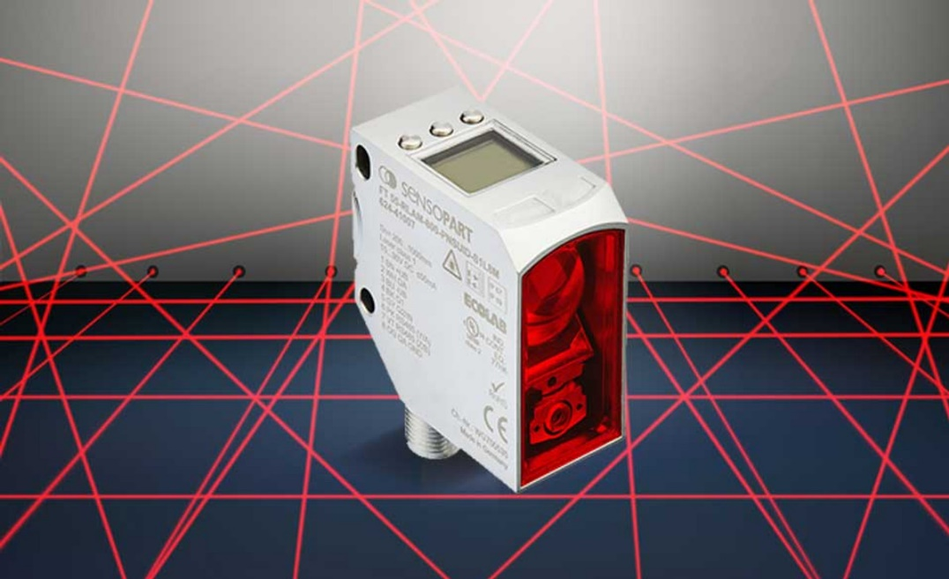
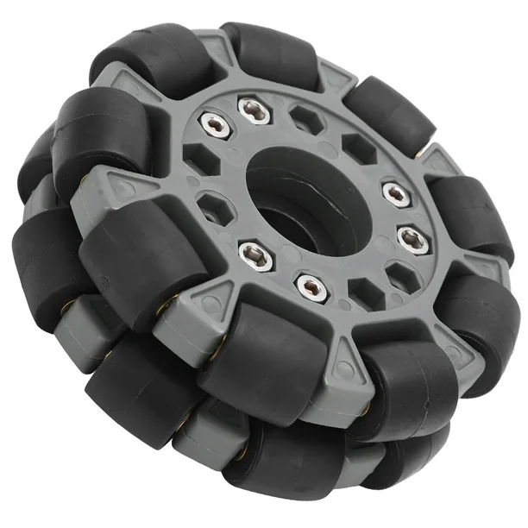
FUTURE MODIFICATIONS
Object Detection
Range
Mobility

Slide 26

Contract Progress
Upon completion, our robot should achieve the following in a specific session:
1. Robot starts at a starting base.
2. Robot recognizes the plants that need watering and starts moving.
3. Robot navigates towards the plant autonomously.

Slide 27
Contract Progress
4. Robot reaches the plant and dispenses the specific quantity of water to the plant.
5. Robot navigates to the next plant if applicable, and repeats steps 4 and 5 for all plants.
6. Robot autonomously navigates back to the base.

Slide 28
Citations
[1] Greenhousemag.com, https://www.greenhousemag.com/article/gmpro-0310-water-plants-automating-irrigation/ (accessed Apr. 25, 2024).

Slide 29
Thank you!
An y Questions?

